Slide 1
Optimizers
An overview

Slide 2
What is optimization?
Optimization task:
Given a function f(p1,...,pn), find input values that maximize / minimize the output of f.
Meta points:
Important to distinguish the task from the algorithm(s) that achieve the task
Optimization is not only for neural networks. Can be any function!
In slides/notebook, function being optimized is called ‘Loss’, but just represents any function

Slide 3
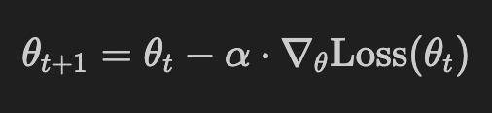
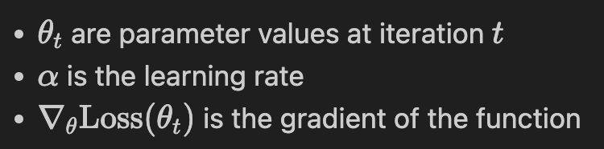
Gradient Descent
Intuitions:
Theorem from maths: gradient points in the direction where Loss increases quickest
Larger learning rate means taking larger steps
Gradient also affects size of the steps
Notes:
Screenshots taken from notebook

Slide 4
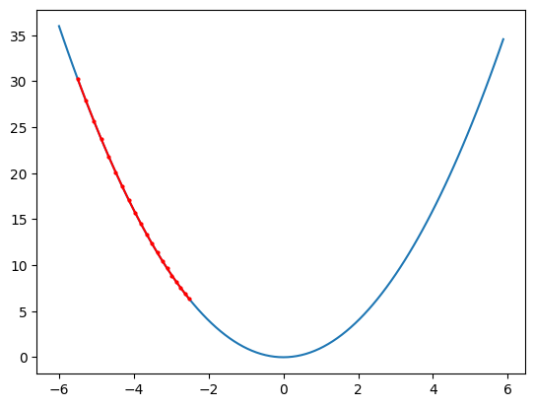
GD Example 1. Small learning rate
f(x) = x^2
X_0 = -5.5
Alpha = 0.02
Notes:
With small learning rate you are heading towards optimum, but slowly

Slide 5
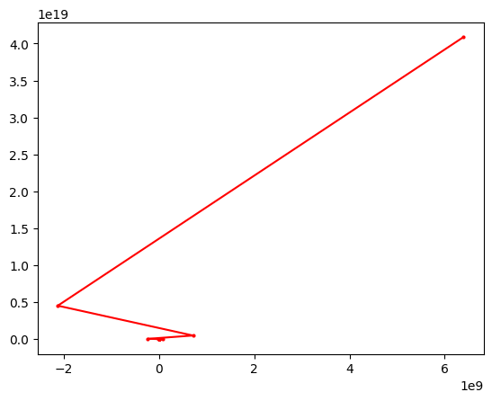
GD Example 2. Large learning rate
f(x) = x^2
X_0 = -5.5
Alpha = 2
Notes:
Steps too large, can explode and get divergence!

Slide 6
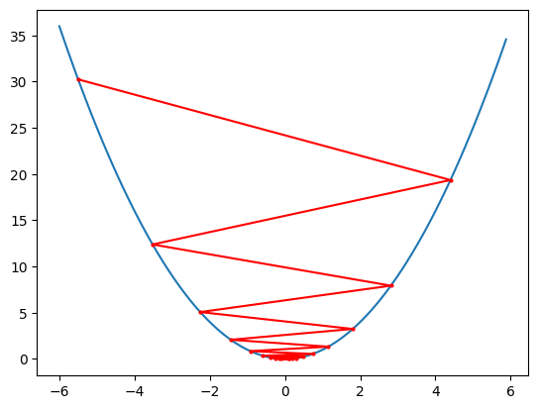
GD. Example 3. ‘Medium’ learning rate
f(x) = x^2
X_0 = -5.5
Alpha = 0.9
Notes:
Bouncing back and forth. Getting closer to optimum but always going too far with each step

Slide 7
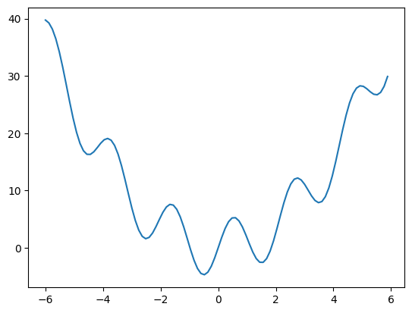
GD. Example with local minima
f(x) = x^2 + 5sin(3x)
X_0 = -5.5
Alpha = 0.01
Notes:
Ask audience what they link will happen.

Slide 8
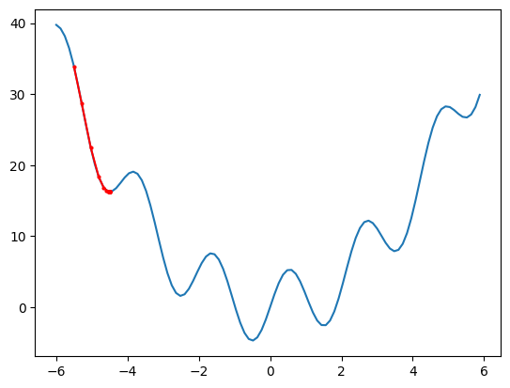
GD. With local minima
f(x) = x^2 + 5sin(3x)
X_0 = -5.5
Alpha = 0.01

Slide 9
Momentum
Intuitions:
In GD, we discard all previous iterations information. Intuitively inefficient/wasteful
Intuition from physics: if you’ve been going in same direction, go faster in that direction
Want to avoid the ‘back and forth’ of medium step size
Achieved by:
Using the average of all previous gradients, not just the current gradient

Slide 10
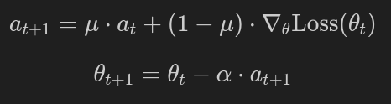
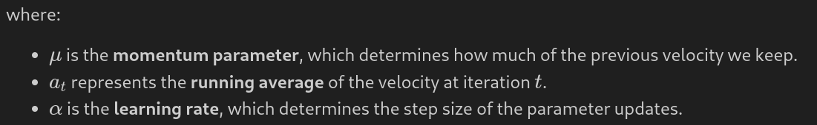
Momentum. Formula
Writing out the average in full:

Slide 11
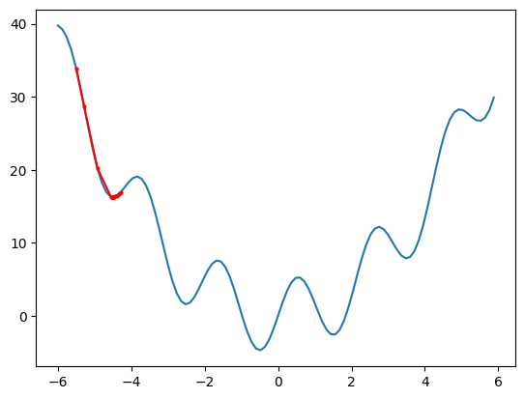
Momentum Example 1
N_steps = 100
Alpha = 0.02
Momentum = 0.5
Notes:
We see it does go little bit up the hill, but not all way.

Slide 12
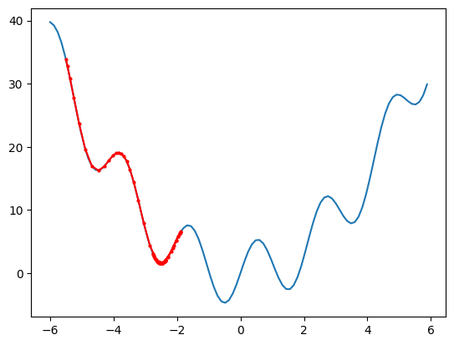
Momentum Example 2. More momentum
N_steps = 100
Alpha = 0.02
Momentum = 0.9
Notes:
With more momentum gets past first one, but not over second hump

Slide 13
RMSProp
Intuition:
1) The magnitude of the gradient isn't always helpful – what matters most is the direction (sign). (example: sign(-10) = -1, sign(10) = +1)
2) Normalize the gradient updates: divide the current gradient by the square root of the running average of the squared gradients.
If your last steps were big and the current one would be smaller, make it even smaller: the curve was steep but we are approaching a less steep region of the function and we need to be more careful.
If we have done small steps recently and now the gradient becomes big, make an even bigger step, we want to move more efficiently in the steep region.

Slide 14
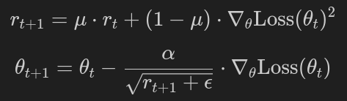
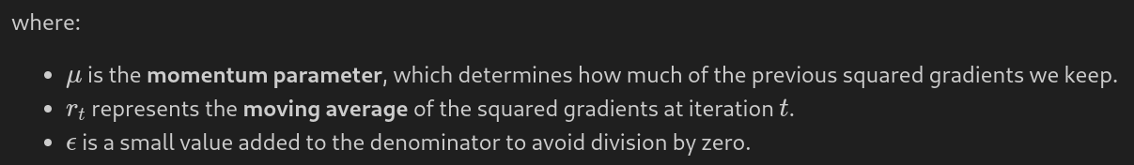
RMSProp. Formula

Slide 15
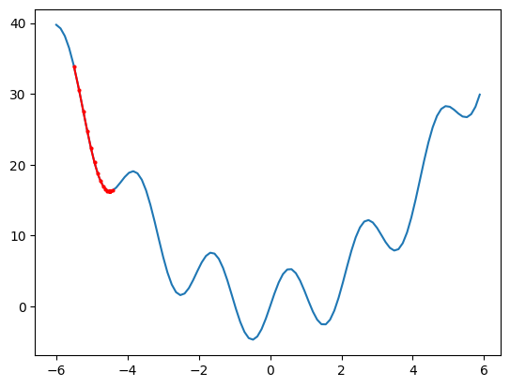
RMSProp Example 1
N_steps = 20
Alpha = 0.1
Momentum = 0.5
(epsilon very small)
Notes:
Step sizes pretty even throughout. Gets smaller only when we start bouncing around and averaging kicks in

Slide 16
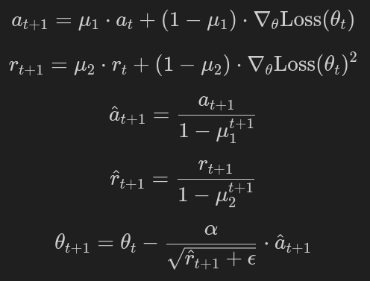
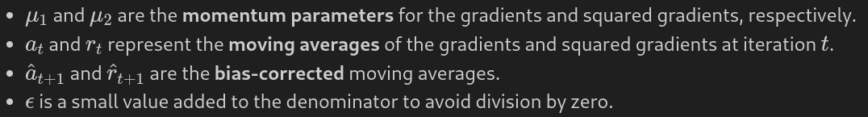
Adam. Intuition: combine momentum and RMSprop
Notes:
I recommend spending very little time here. The mathsy people can stare at it in their own time and for non maths people it is enough to know it is combination of momentum and rmsprop

Slide 17
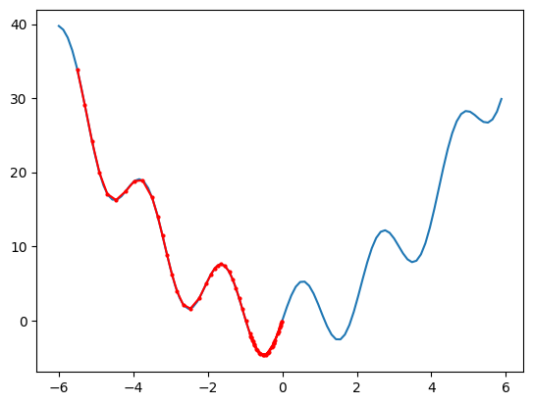
Adam Example
N_steps = 60
Alpha = 0.2
Momentum_grad = 0.9
Momentum_grad_squared = 0.5
(epsilon very small)

Slide 18
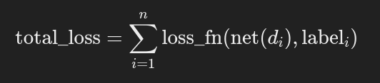
Gradient descent and neural networks
Example of classification
dataset = [(d1,label_1), (d2, label_2), ..., (dn, label_n)]
neural network net with parameters p
Loss function is loss_fn (e.g. cross entropy)
Q1. What’s the function we are trying to optimize?

Slide 19
Q2. Why do you not actually want to minimize this total loss?
Overfitting
Use a validation set:
While training, training loss typically decreases. But the validation loss can start to increase after a certain point, signaling overfitting.
The goal of optimization is to not just minimize the training loss, but to find a balance where the model generalizes well (i.e., performs well on unseen data).
To combat overfitting: regularization (L1, L2 regularization), dropout, early stopping, data augmentation, …

Slide 20
Stochastic Gradient Descent
Three variations:
Batch GD: compute loss over entire dataset (too much computation)
Stochastic GD: compute loss on *one* randomly selected sample (doesn’t parallelize well)
Mini-batch GD: compute loss on a batch of samples of size ‘batch_size’. (this is the standard in deep learning)

